Slide 1
BrewNinja Automated Homebrew Assistant
by Jarett Creason
August 14, 2013

Slide 2
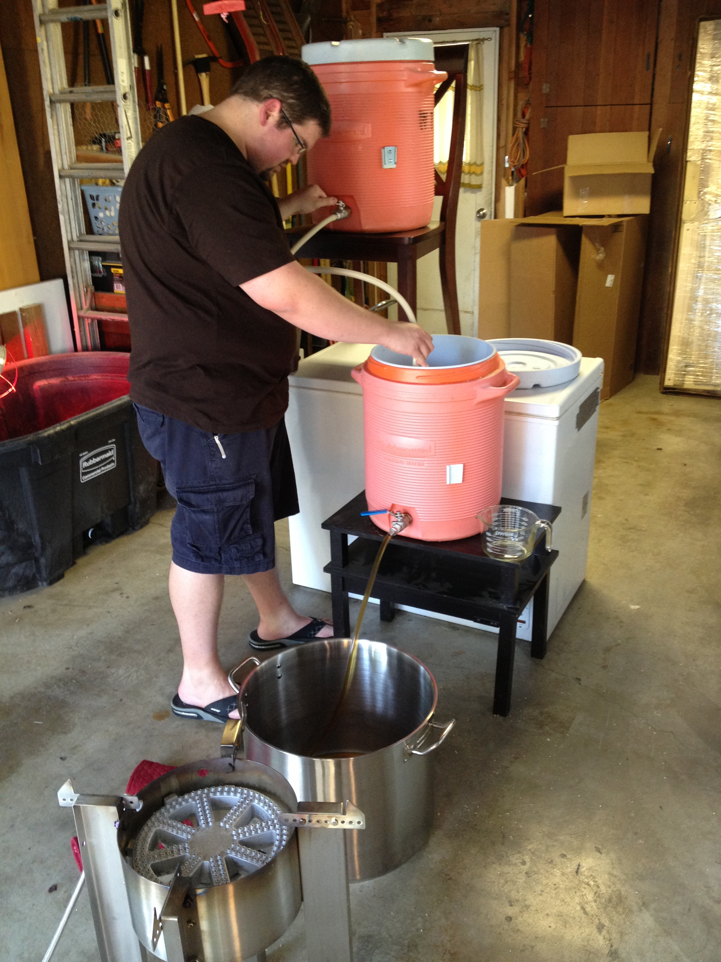
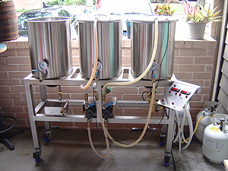
What and Why? (hint, it starts with “b” and ends with “eer”)
Old
Goal

Slide 3
License & Technologies
Software
Hardware
BrewNinja (GPL3)
Java 7 update 6+
Pi4J (Apache SL v2)
JavaFX
MySQL 5.5
Hibernate 4
Maven 3
Log4J 2
Raspberry Pi
Custom Relay Board
Waterproof Temp Sensors
Honeywell LP Valves
Chugger Pumps
A lot of other brew items

Slide 4

Demo & Questions

